Slide 1



Supply Chain Management
Student Name : A. Surya Kumari
Collage Name : NRI INSTITUTE OF TECHONOLGY

Slide 2

Learning Objectives
Here are the key learning objectives in Supply Chain Management (SCM) in short form:
Understand Supply Chain Basics: Learn the components and functions of a supply chain (suppliers, manufacturers, distributors, customers).
Develop Analytical Skills: Apply data analysis and forecasting techniques for supply chain decision-making.
Manage Inventory and Operations: Learn inventory control methods and how to optimize production scheduling.
Optimize Logistics and Distribution: Understand transportation, warehousing, and distribution strategies to reduce costs.
Apply Supply Chain Strategies: Implement Lean, Agile, or Hybrid strategies based on demand and cost factors.
Understand Global Supply Chains: Learn about international sourcing, trade regulations, and risk management in global operations.
GOAL
Source :
www.freepik.com/

Slide 3
Tools and Technology used
The following technologies and tools will be utilized in the project:
Power BI:
The primary tool for data visualization and dashboard creation. Power BI allows for the integration of various data sources and provides powerful visualization capabilities, making it ideal for creating interactive dashboards.
SQL Server:
Used for data storage and retrieval. SQL Server can handle large datasets and complex queries, making it suitable for managing supply chain data efficiently.
ETL Tools:
Tools like Microsoft Power Query or Azure Data Factory will be employed for data extraction, transformation, and loading processes. These tools help automate data preparation tasks, ensuring that data is ready for analysis.
Excel:
Excel may be used for initial data cleaning and transformation, especially if data is sourced from spreadsheets or requires manual adjustments before being imported into Power BI.
Data Sources:
The project will integrate data from various sources, including ERP systems, inventory management systems, logistics platforms, and external data sources (e.g., market trends, supplier performance).

Slide 4
Methodology
Here's a brief overview of the key methodologies used in supply chain management:
Just-In-Time (JIT): Minimizes inventory by receiving goods only when needed for production, reducing storage costs but vulnerable to disruptions.
Lean Supply Chain: Focuses on eliminating waste and increasing efficiency throughout the supply chain by improving processes and reducing excess.
Agile Supply Chain: Prioritizes flexibility and quick adaptation to market changes, ensuring responsiveness to demand shifts or disruptions.
Six Sigma: Uses data-driven methods to reduce defects and process variability, improving quality and efficiency in the supply chain.
Theory of Constraints (TOC): Focuses on identifying and improving the most significant bottleneck in the supply chain to enhance overall performance.
Vendor-Managed Inventory (VMI): Suppliers manage inventory at the buyer’s location, improving inventory turnover and collaboration.

Slide 5
Problem Statement:
Organizations often encounter significant challenges in managing their supply chains due to:
Fragmented Data Sources: Data is often siloed across different systems, making it difficult to obtain a unified view of supply chain performance.
Lack of Real-Time Visibility: Without real-time data, organizations struggle to respond quickly to changes in demand, inventory levels, or supplier performance.
Inefficient Processes: Manual data entry and reporting can lead to errors and delays, hindering timely decision-making.
Inability to Identify Bottlenecks: Without a centralized dashboard, it is challenging to pinpoint inefficiencies and areas for improvement in the supply chain.
These issues can result in increased operational costs, delayed deliveries, and ultimately, customer dissatisfaction. This project addresses the need for a centralized, interactive dashboard that consolidates data and provides actionable insights to improve supply chain performance.

Slide 6
Solution:
The proposed solution is to develop a comprehensive Supply Chain Management Dashboard using Power BI that integrates data from various sources to provide real-time insights into supply chain performance. This dashboard will serve as a centralized platform for stakeholders to monitor key performance indicators (KPIs) and make informed decisions.
Data Integration:
The dashboard will utilize Power BI’s robust data connectors to pull data from multiple sources, including ERP systems (like SAP or Oracle), inventory management software, and logistics platforms.
An ETL (Extract, Transform, Load) process will be implemented to ensure that data is cleaned, transformed, and loaded into Power BI efficiently. This will involve removing duplicates, handling missing values, and standardizing data formats.
Interactive Dashboard:
The dashboard will be designed to be intuitive and user-friendly, featuring visualizations that allow stakeholders to easily interpret data. Key metrics to be visualized include:
Inventory Levels: Displaying current stock levels against reorder points.
Order Fulfillment Rates: Tracking the percentage of orders fulfilled on time.
Supplier Performance Metrics: Evaluating suppliers based on on-time delivery and quality scores.
Logistics Efficiency: Analyzing

Slide 7
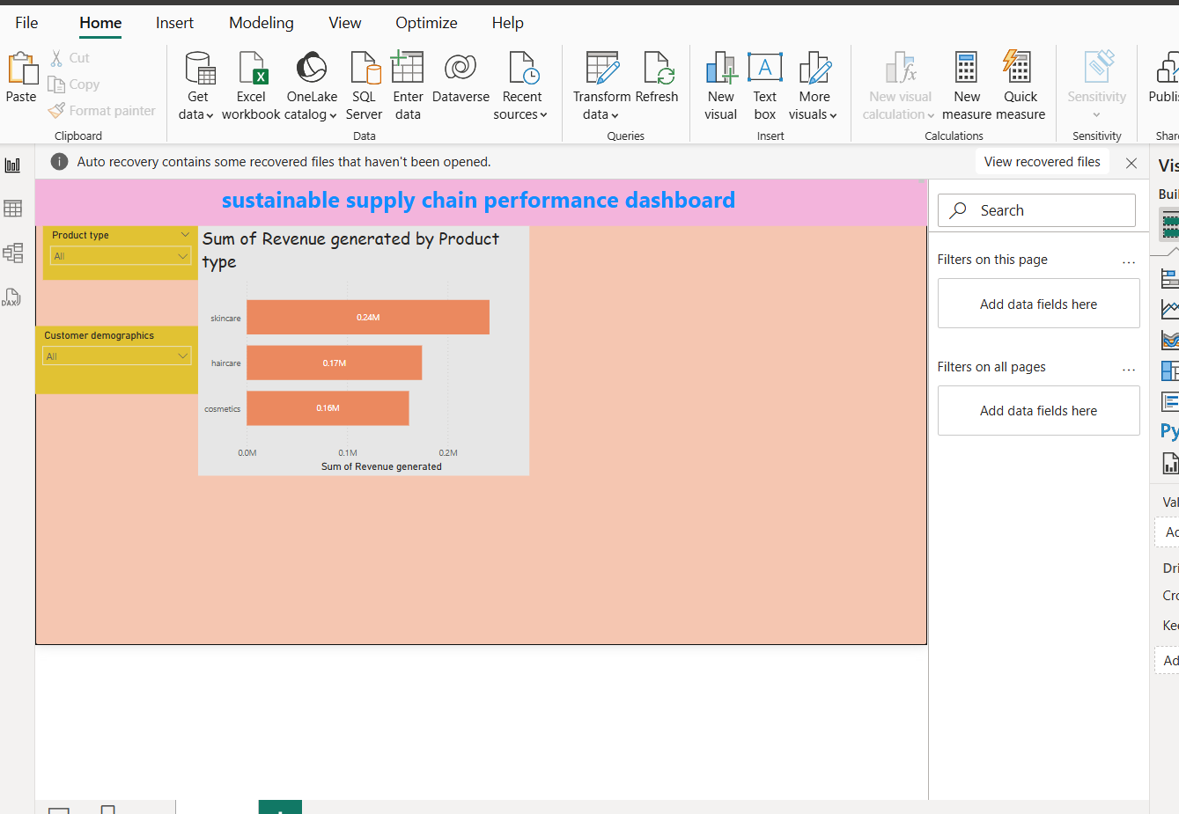
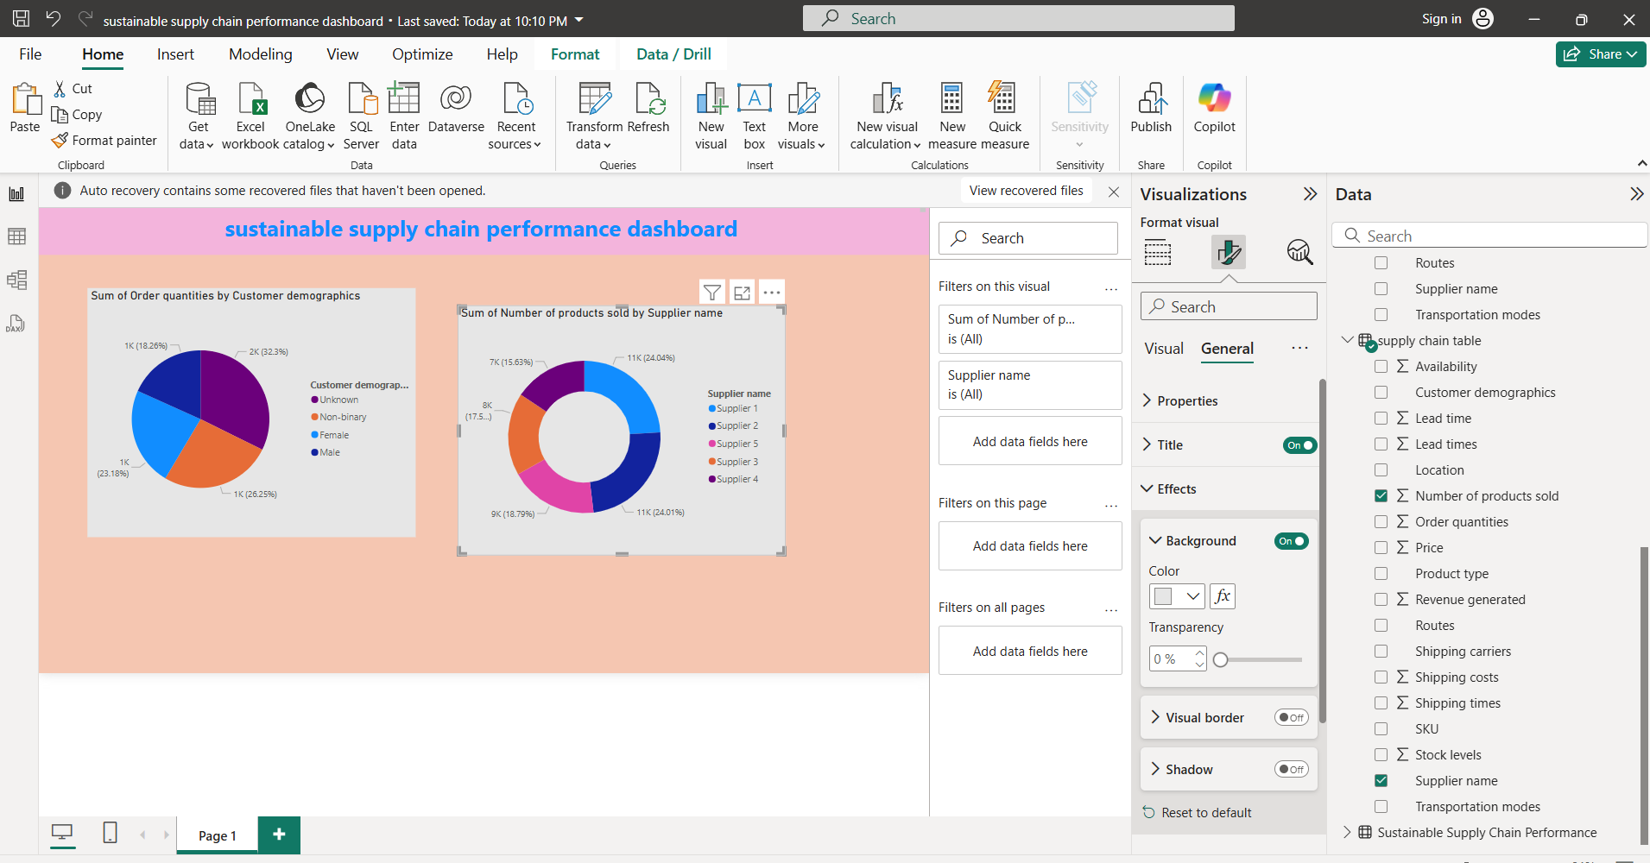
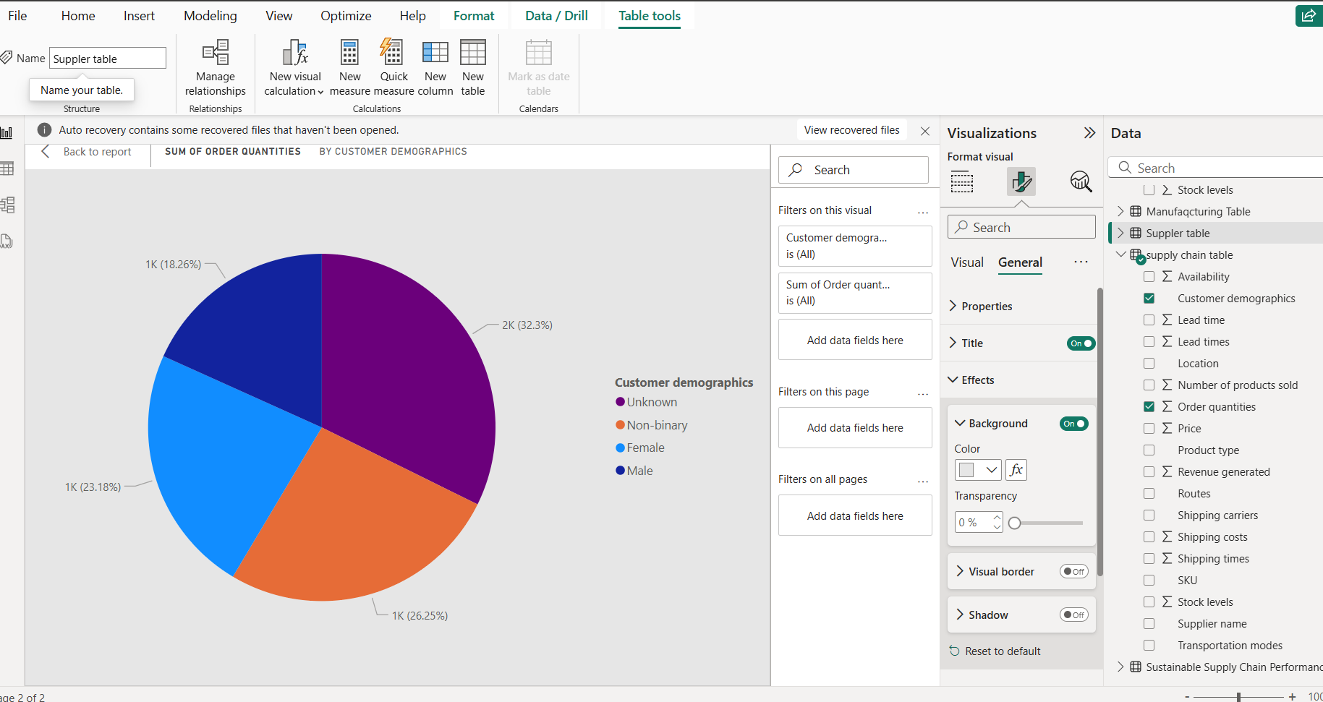
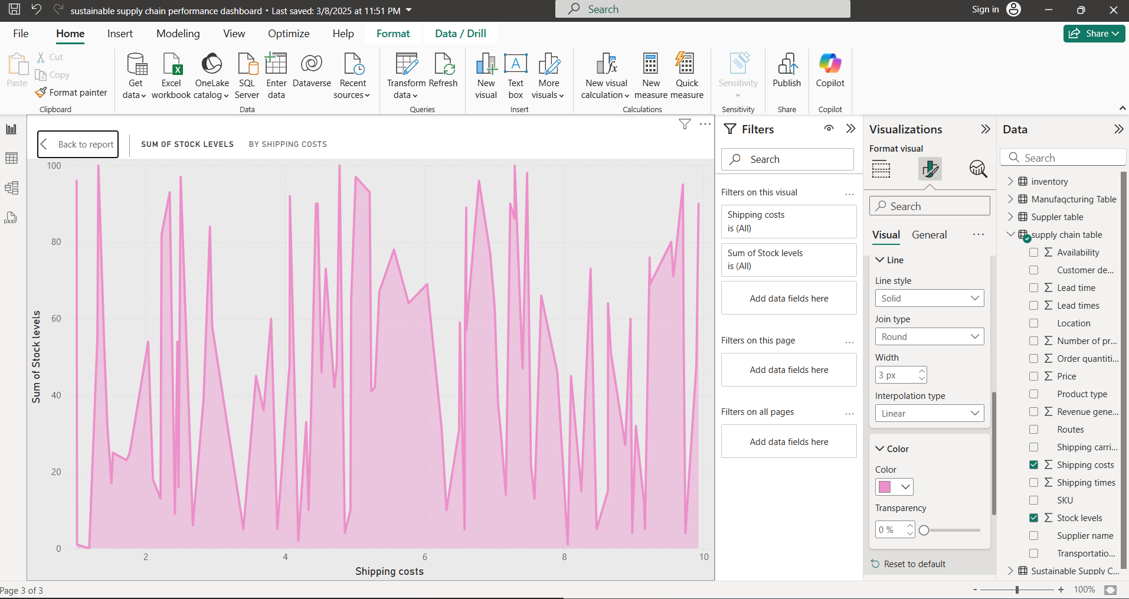
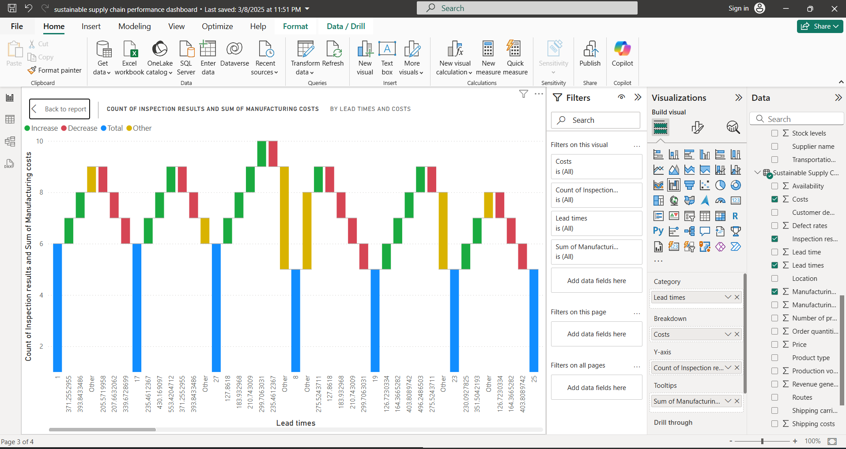
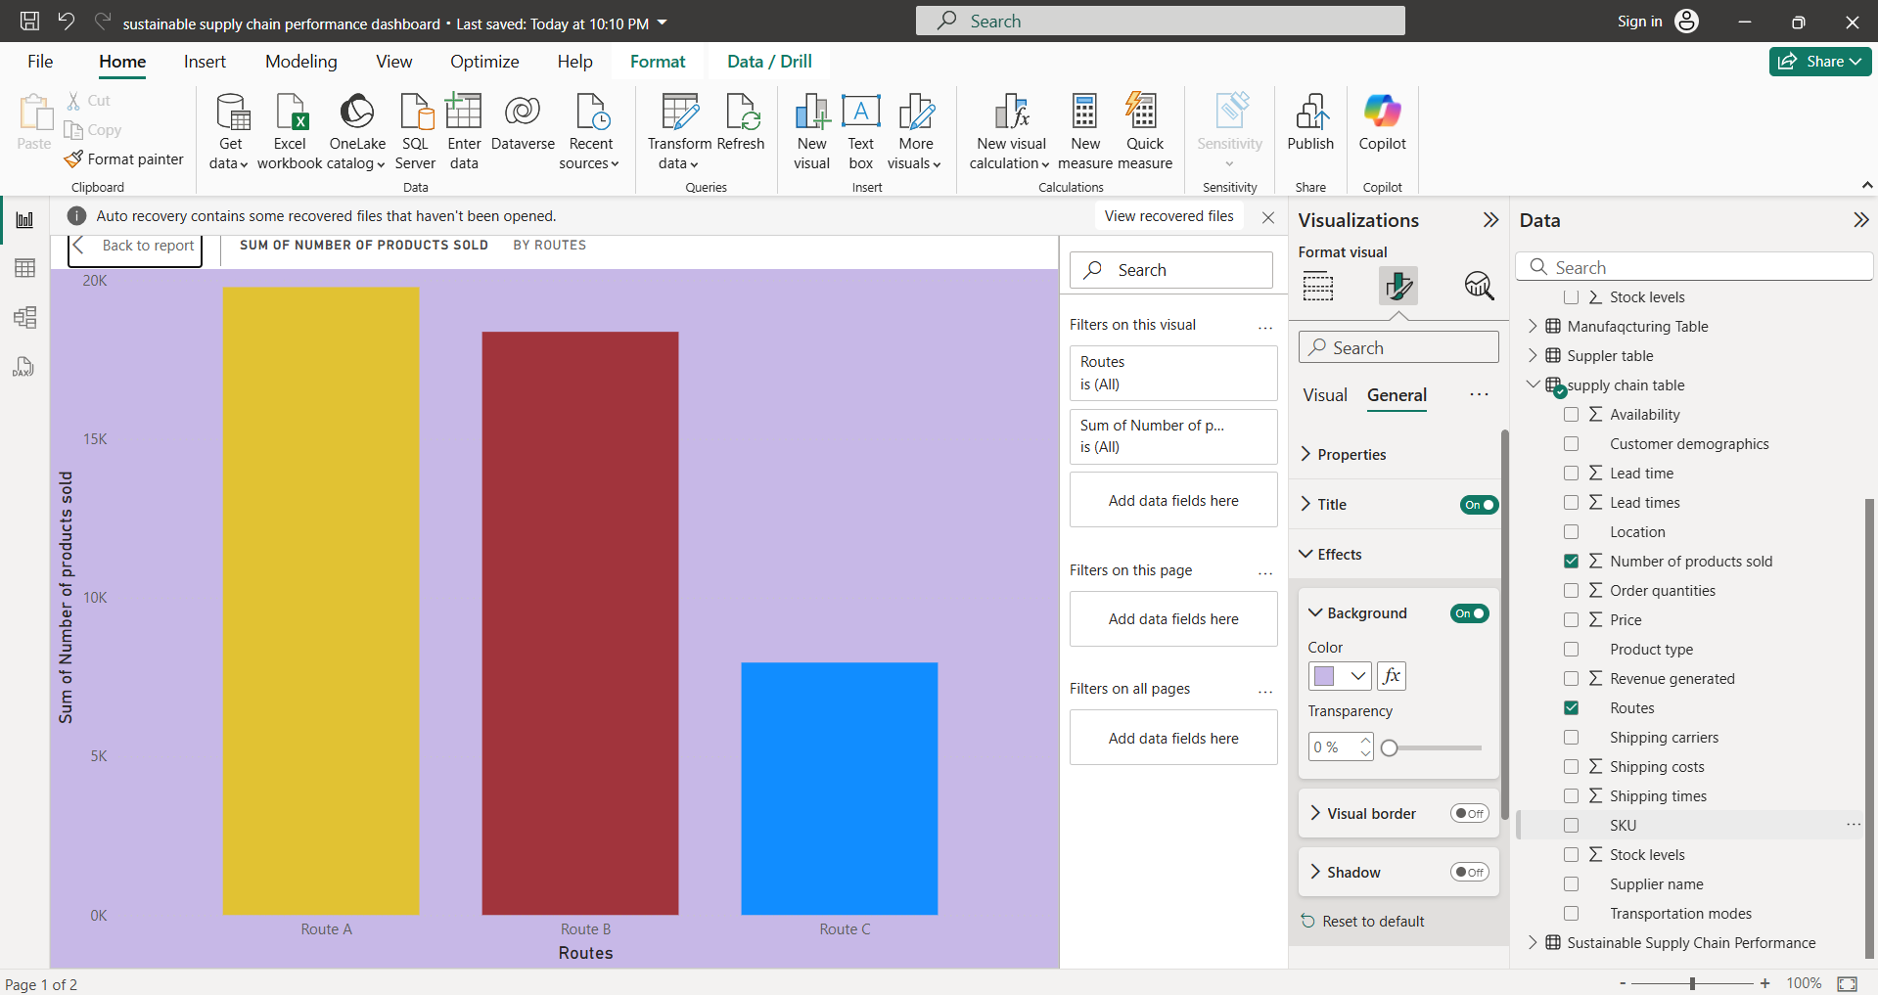
Screenshot of Output:

Slide 8
Conclusion:
The Supply Chain Management Dashboard developed in this project provides a powerful tool for organizations to monitor and optimize their supply chain operations. By leveraging Power BI’s data visualization capabilities, stakeholders can gain real-time insights into key performance indicators, enabling them to make informed decisions and respond quickly to changes in the supply chain.
The project demonstrates the value of integrating data from multiple sources to create a unified view of supply chain performance. By identifying trends and inefficiencies, organizations can implement strategies to reduce costs, improve service levels, and enhance overall operational efficiency. Future enhancements could include advanced analytics,
such as predictive modeling for demand forecasting and machine learning algorithms to optimize inventory management.
This project not only addresses the immediate needs of supply chain visibility but also lays the groundwork for continuous improvement and data-driven decision-making in the organization.

